Slide 1
PC Maintenance: Preparing for A+ Certification
Chapter 13: Managing CD Drives

Slide 2
Chapter 13 Objectives
Identify types of optical drives
Understand measurements of drive performance
Install a CD drive
Understand CD-R and CD-RW
Understand DVD drives
Troubleshoot optical drive problems

Slide 3
Types of Optical Drives
Standard CD
Writeable CD (CD-R, CD-RW)
Standard DVD
Writeable DVD (DVD-R, DVD-RW, DVD+R, DVD+RW, CD-R, CD-RW)

Slide 4
What is “X”?
Theoretical maximum data transfer rate
Multiple of 150Kbps it can read. For example, 32X CD = 4.8Mbps
Transfer rate is only theoretical due to hardware limitations
Also refers to rotational speed

Slide 5
Access Time
Elapsed time between PC’s request and drive’s delivery
Measure of mechanical ability of drive to move read head to correct spot
75ms is typical

Slide 6
Constant Linear Velocity (CLV)
Found in older regular CD-ROM drives
Found in all PC-based writeable drives
Data read at the same area per second
Disk spins faster when head is near center

Slide 7
Constant Angular Velocity
Found in newer regular CD-ROM drives
CD rotates at a constant speed
Amount of data per second varies depending on spot on disk being accessed

Slide 8
Other Performance Factors
Interface (IDE, SCSI, USB)
Competition for interface bandwidth
Drive cache
CPU usage
DMA usage

Slide 9
Installing a CD Drive
Set any jumpers on drive needed
Insert drive in bay
Connect ribbon cable
Connect power cable
(Optional) Connect audio cable

Slide 10
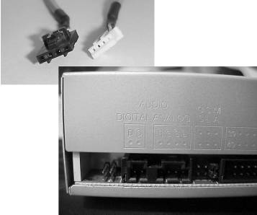
Audio Cable
Allows CD drives to play audio CDs in analog mode
Connects directly from sound card to CD drive

Slide 11
Real-Mode CD Drivers
Config.sys:
  DEVICE=[driver] /D:[name]
  Example:
  DEVICE=SSCDROM.SYS /D:SSCD0001
Autoexec.bat:
  MSCDEX.EXE /D:[name]
  Example:
  MSCDEX /D:SSCD0001

Slide 12
DVD
Digital Versatile Disc (data)
Digital Video Disc (movies)
Holds at least 4.7GB of data or 135 minutes of video
Single and double-sided
Single and double-layered

Slide 13
MPEG Decoders
Required to play DVD movies
Hardware or software
Typically software on newer systems

Slide 14
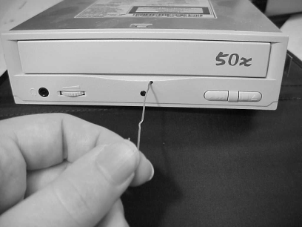
Troubleshooting CD Problems
CD will not eject:
Insert wire into release hole on front of drive

Slide 15
Troubleshooting CD Problems
Noisy drive:
  Replace drive
CD drive not bootable:
  Enable CD booting in BIOS setup
  Change boot order to bypass other boot disks if needed (such as hard drive)
  Ensure that the CD being read is bootable

Slide 16
How CD-R Works
Laser hits photosensitive dye on surface of blank disc
Where laser touches, surface becomes less reflective
CD drive perceives less reflective area as a pit

Slide 17
Troubleshooting CD-R Recording
Buy a CD-RW drive with a large buffer
Do not use PC while recording
Place an IDE CD drive on its own ribbon cable
Do a test write first
Lower the recording speed
Create a disc image rather than copying CD-to-CD

Slide 18
How CD-RW Works
Laser has three power settings
  High: Heats area, creating a non-reflective area simulating a pit
  Low: Re-heats the same area again, causing it to revert back to original reflectivity
  Lowest: Reads data without changing it

Slide 19
Bootable CDs
Contain two files for booting:
  BOOTCAT.BIN: A catalog file
  BOOTIMG.BIN: An image file containing a virtual floppy disk
Create a bootable CD:
  Use a CD writing utility program
  Create a bootable floppy first
  Use utility to create a BOOTIMG.BIN on disk matching that bootable floppy’s content

